Slide 1
PR- 28
Signal Processing Primitives With Quantum Algorithm
G-RIIS
(G=Gal Winer(Team Lead), R=Risav, I= Ibrahim )

Slide 2
We have new team member
Ini Ekpenyong

Slide 3
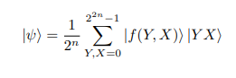
Novel Enhanced Quantum Representation
NEQR
The NEQR is a quantum gray image representation model that offers a methodology , which uses a gray image (size: 2^{n} ×2^{n}) parameters as input and encode them to a quantum system or circuit that uses superposition and entanglement to represent the image parameters. The circuit is build of 2n + 8 qubits. 8-qubits are used to store the gray scale value f(Y, X) of the pixels, and 2n-qubits are for the pixel position (Y, X). The final state of this quantum circuit, which represents the image, is given as:

Slide 4
Novel Enhanced Quantum Representation(NEQR)
Where |f(Y, X)⟩ can be written in the bit sequence as,
which represents the encoded grey scale value of pixels and
|Y X⟩ = |Y ⟩ |X⟩ = |Yₙ₋₁Yₙ₋₂ . . . Y₁Y₀⟩ |Xₙ₋₁Xₙ₋₂ . . . X₁X₀⟩
Is to store the corresponding vertical and horizontal coordinate values of the pixels

Slide 5
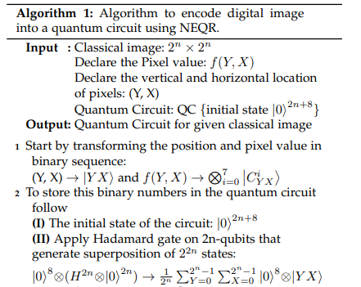
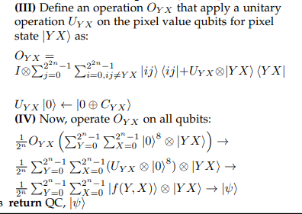

Slide 6
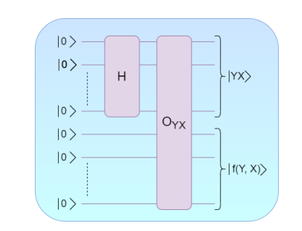
NEQR procedure circuit using (2n + 8)-qubits. Here, H is the Hadamard gate and O_{XY} is a controlled gate that operate U_{XY} on pixel qubits, when 2n-qubits are in the state |Y X⟩, to obtain |f(Y, X)⟩.

Slide 7
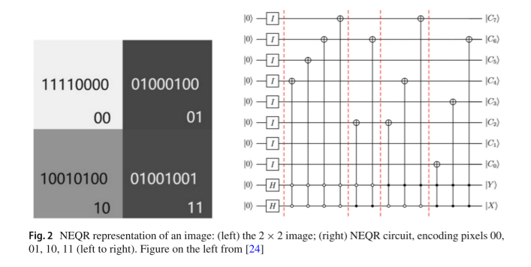
NEQR EXAMPLE

Slide 8
TWO CLASSIQ PYTHON SDK CODE:
2X2 NEQR Implementation (with ccx gates)
MxM NEQR Implementation (with mcx gates)

Slide 9
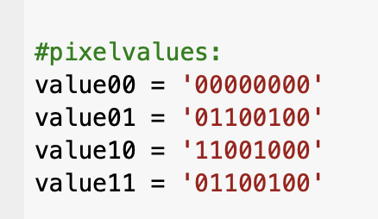
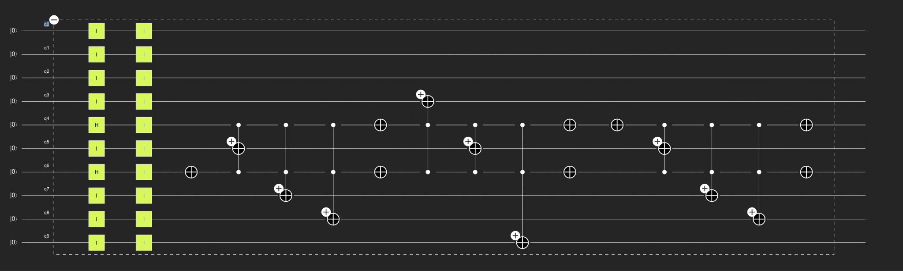
CIRCUIT: 2X2NEQR (with ccx gates)
TODO1: Order of qubit is destroyed after ccx gates are applied.Are there a way to fixed it?
TODO2: Are there a way to put quantum barrier in classiq environment ?

Slide 10
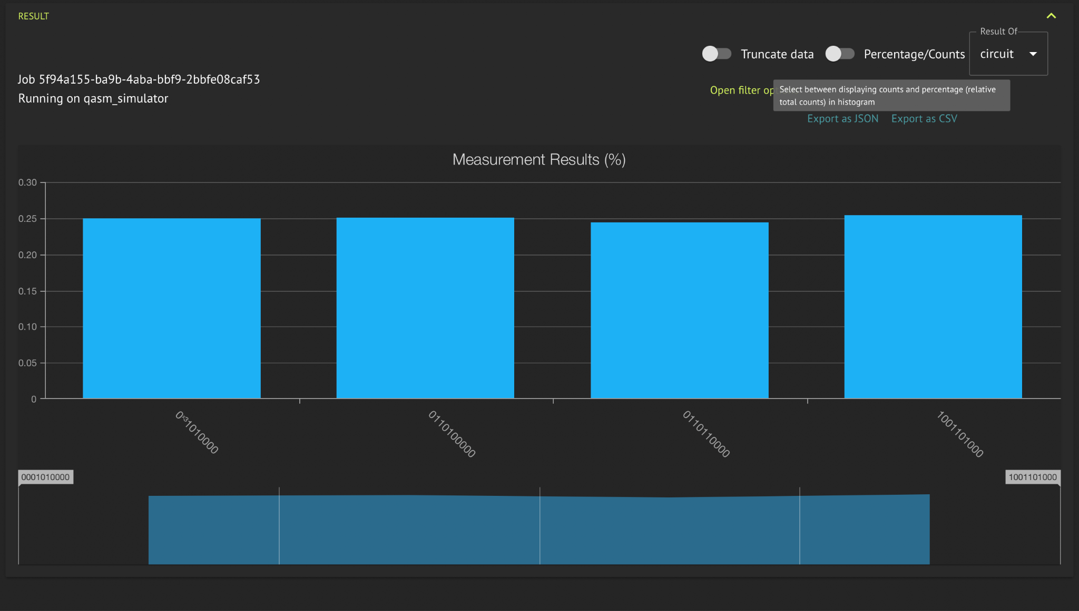
EXECUTION: 2X2NEQR (with ccx gates)

Slide 11
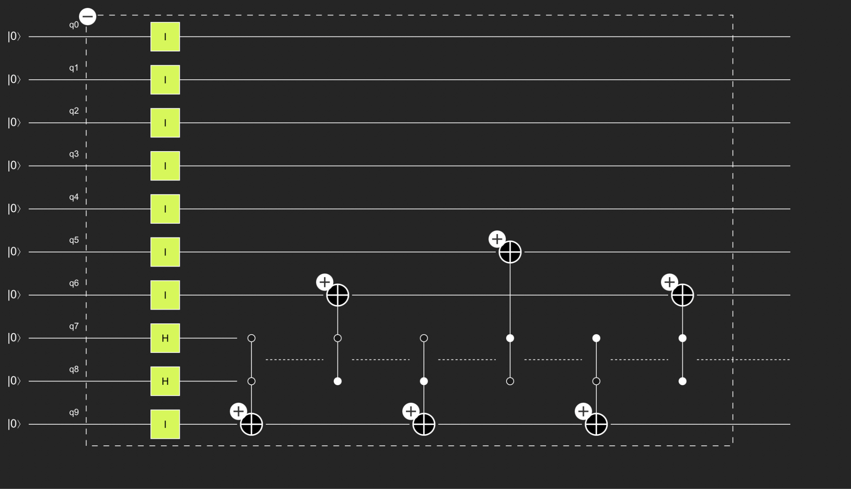
CIRCUIT: mxm NEQR (with mcx gates) for 2x2 image

Slide 12
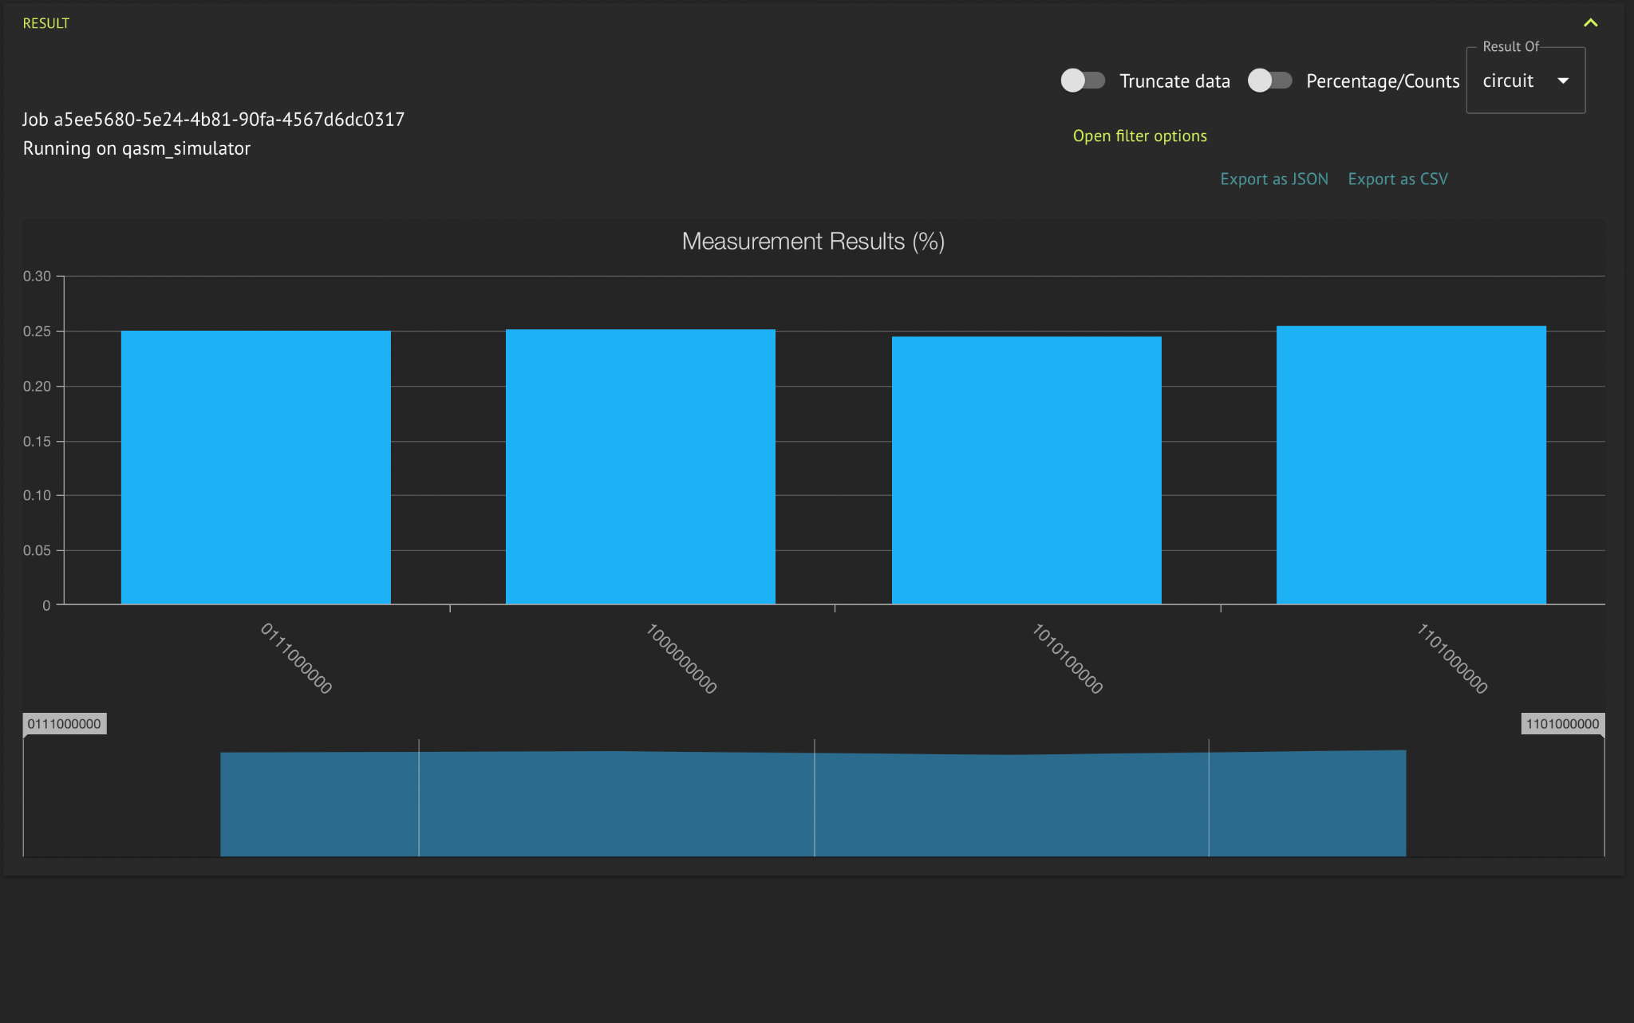
EXECUTION: mxmNEQR.ipynb (with mcx gates) for 2x2 image

Slide 13
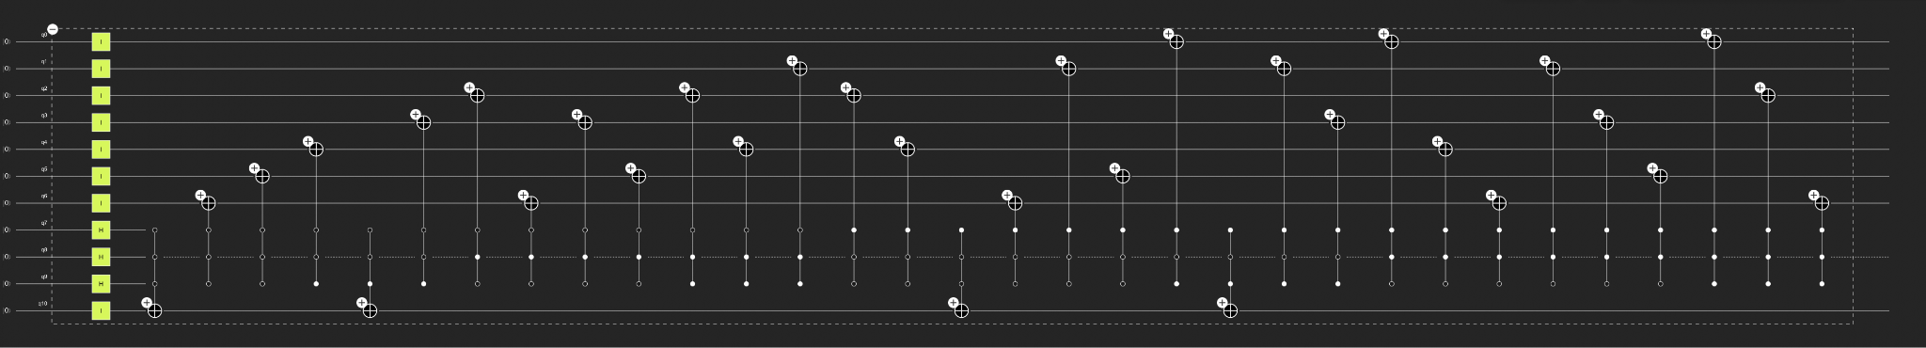
CIRCUIT: mxm NEQR.ipynb (with mcx gates) for 3x3 image

Slide 14
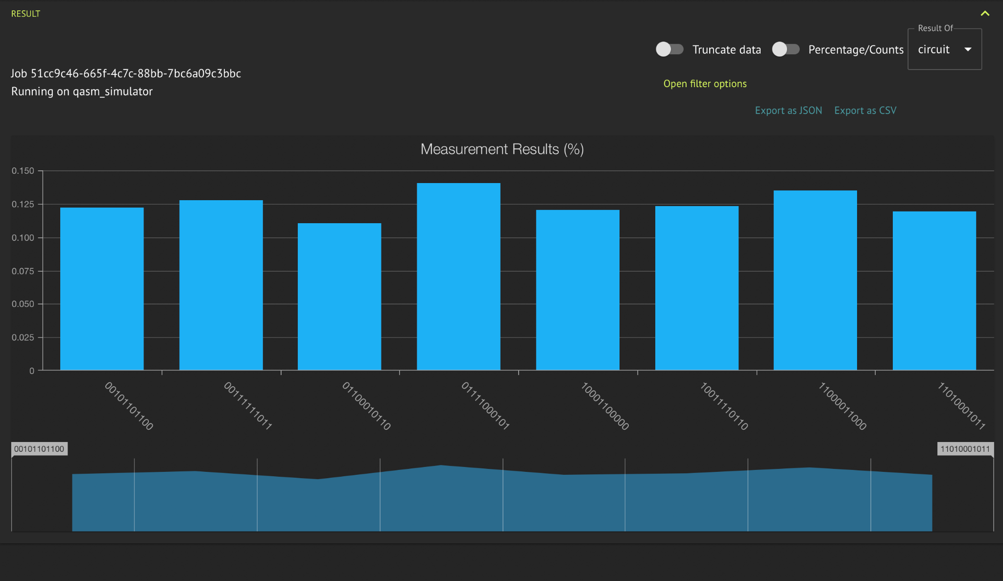
EXECUTION: mxm NEQR.ipynb (with mcx gates) for 3x3 image
TODO3: Measurement results are not all 0.125 is it acceptable because of the nature of the qasm_simulator ?

Slide 15
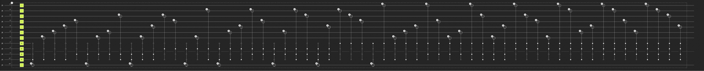
CIRCUIT: mxm NEQR.ipynb (with mcx gates) for 4x4 image

Slide 16
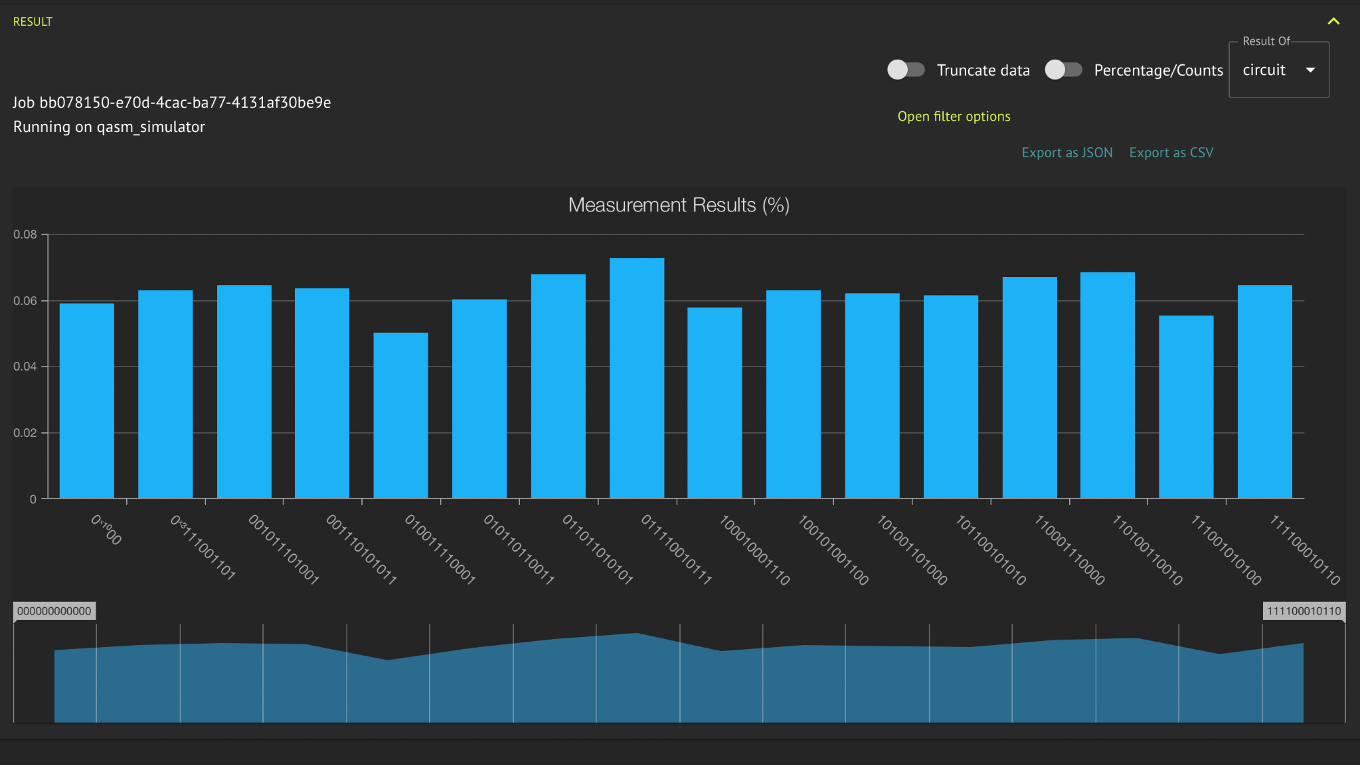
EXECUTION: mxmNEQR.ipynb (with mcx gates) for 4x4 image
QUESTION3: Measurement results are not all 0.0625 is it acceptable because of the nature of the qasm_simulator ?

Slide 17
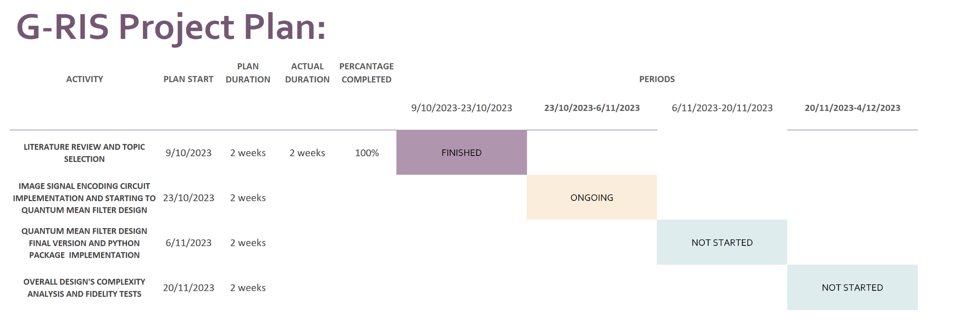
Initial Plan

Slide 18
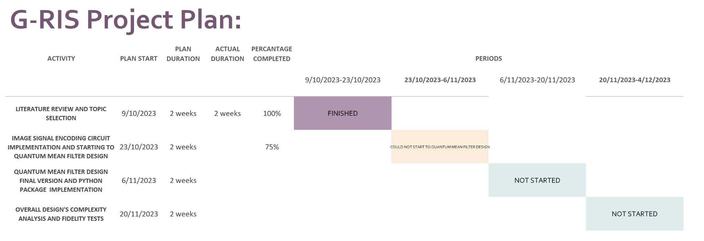
Current Situation

Slide 19
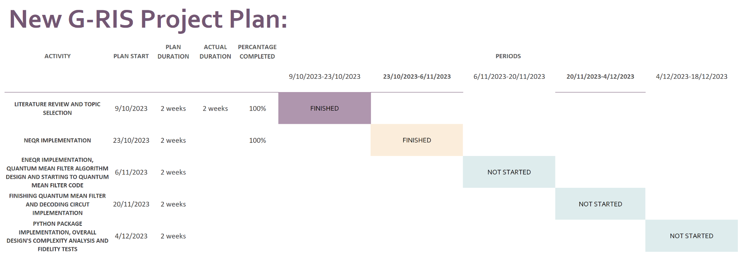
New Plan

Slide 20
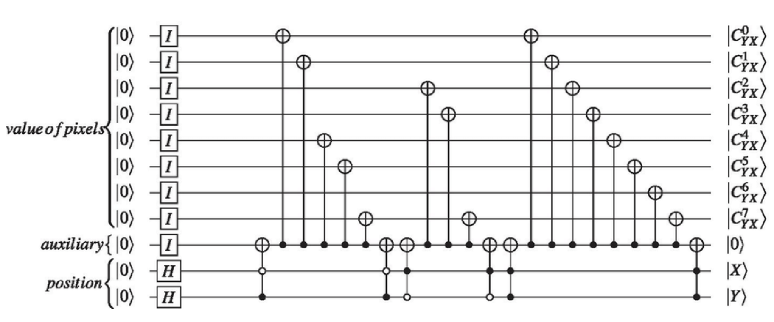
ENEQR:The second enhanced NEQR
https://www.researchgate.net/figure/A-quantum-circuit-for-the-ENEQR-representation-of-a-22documentclass12ptminimal_fig4_354247686

Slide 21


